Slide 1

Personal Image Classifier
Lesson 2

Slide 2
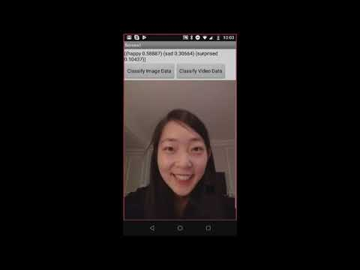
PIC Demo App
You will use the model you trained in Lesson 1 in an App Inventor project

